Slide 1
SS ZG653 (RL 16): Software Architecture Design Patterns- Behavior
Instructor: Prof. SantonuSarkar
March 24, 2015

Slide 2
Behavioral Patterns
Design Patterns

Slide 3
What is it?
A set of design patterns
that identify common communication between objects. These patterns increase flexibility in carrying out communication
We shall study
Iterator pattern- Access elements of an aggregate sequentially
Observer pattern- Publish/Subscribe or Event Listener
Strategy pattern- Select Algorithms on the fly
Visitor pattern- Separate an algorithm from an object
Command pattern- Encapsulate an action, parameters, state

Slide 4
Iterator Pattern
16.1

Slide 5
Iterator Pattern
Intent
Provide a way to access the elements of an aggregate object sequentially without exposing its underlying representation
An aggregate object is an object that contains other objects for the purpose of grouping as a unit
Also called a container or a collection
Examples are a linked list and a hash table.
Also Known As Cursor
Motivation
A list should allow a way to traverse its elements without exposing its internal structure
It should allow different traversal methods
It should allow multiple traversals to be in progress concurrently

Slide 6
What are Iterators
Iterators helps to iterate or traverse the collections[ Moving from the first element collection to its last element]
Example of Collections : Arrays, Linked Lists etc..
Given a list of numbers say 4, -5, 10, 6, 8, 20, -10, 30
0
1
2
3
4
5
6
7
Array Representation
4 | -5 | 10 | 6 | 8 | 20 | -10 | 30
Linked List Representation
Start
4
-5
10
6
8
20
-10
30

Slide 7
Iterators cont….
Traversal in Java
Traversal in C
LinkedList list = new LinkedList() ListIteratorLtr = list.listIterator(); while(Ltr.hasNext() { Object current= Ltr.next(); ................... }
Advantages of Iterators
Iterators does not expose internal structure [only return elements for use]
More than one iterators can be attached to a single collection.
Link Ltr = list.head;
while(Ltr != null) {
Object current= Ltr.data;
Ltr= Ltr.next;
}
Disadvantages w/o iterator
Internal structure links exposed to user
Only one way traversal at a time

Slide 8
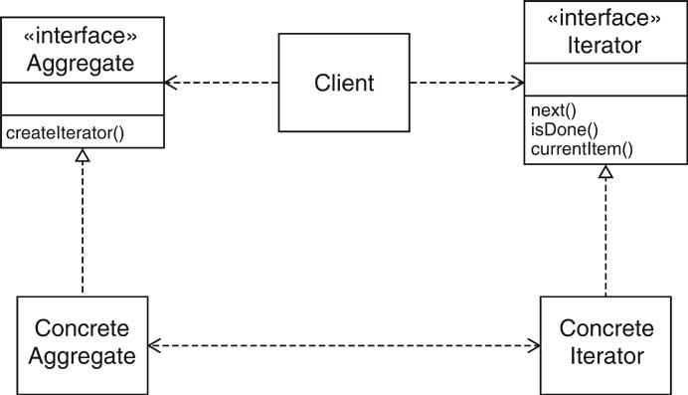
Solution
Define an iterator that fetches one element at a time
Each iterator object keeps track of the position of the next element
If there are several aggregate/iterator variations, it is best if the aggregate and iterator classes realize common interface types.

Slide 9
Observer Pattern
16.2

Slide 10
Observer Pattern
Context
Certain objects need to be informed about changes in occurred in other objects whenever certain event occurs
Example (Event mgmt)
A real time stock update system that publishes stock prices whenever a change in stock price happen
Clients can be web-based application or a smart phone application
These clients need to be alerted whenever such change occurs
Example (MVC Architecture Pattern)
Button notifies action listeners when Button is Pressed
Views attach themselves to model in order to be notified
Action listeners attach themselves to button in order to be notified

Slide 11
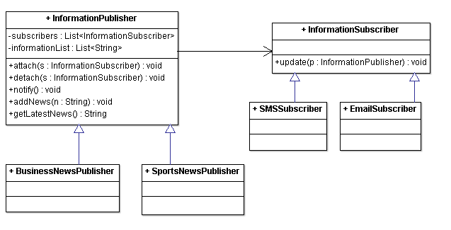
Observer Pattern Class Diagram
Subject which can be abstract class or interface
Concrete
observers
p.getLatestNews();
for(InformationSubscriber s : subscribers) {
o.update(this);
}

Slide 12
Interaction
Define an observer interface type
Concrete observers can model different communication channels or entities interested in certain class of events
Also called Subscriber
Use Factory pattern to create new observer
The subject maintains a collection of observers
A specialized subject can model a specific type of event
The subject supplies methods for attaching and detaching observers.
Also called Publisher
Whenever an event occurs, the subject notifies all observers

Slide 13
Implementation Issues
Many to Many
Many subscribers may need to observe many events (subjects)
During notification, the subject reference is passed as a parameter (recall the class diagram)
Triggering update
If updates are very frequent there can be many consecutive updates
Observer can be made responsible to initiate notify operation when it needs (better efficiency)
Just before notify() is called…
Subject state should be updated properly so that the observer gets the updated state

Slide 14
Push vs Pull
Push
subjects send detailed information about the change to the observer whether it uses it or not
Could be inefficient when a large amount of data needs to be sent and it is not used
Send only the information required by the observer.
Subject should be able to distinguish between different types of observers and to know the required data of each of them, ➔ subject is more coupled to observer
Pull
The subject just notifies the observers about the change
Observer pulls the required data
Communication is done in 2 steps– extra overhead

Slide 15
Strategy Pattern
16.3

Slide 16
Strategy Pattern
Context:
A class can benefit from different variants for an algorithm
Clients sometimes want to replace standard algorithms with custom versions

Slide 17
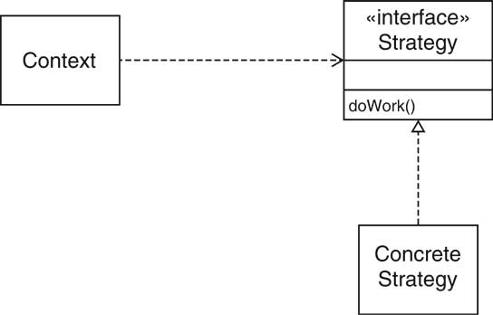
Strategy Pattern Overview
Interaction
Define an interface type that is an abstraction for the algorithm
Actual strategy classes realize this interface type.
Clients can supply strategy objects
Whenever the algorithm needs to be executed, the context class calls the appropriate method (doWork()) of the strategy object

Slide 18
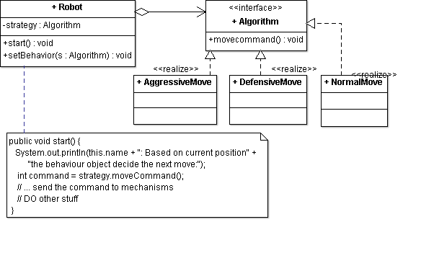
Strategy pattern class diagram
The Overall “Context”
Different concrete strategies (algorithms) to move the robot

Slide 19
Usage of Strategy Pattern
public class RunRobot{ public static void main(String[] args){ Robot r1 = new Robot("Big Robot"); Robot r2 = new Robot(“D2"); r1.setBehavior(new AgressiveMove()); r2.setBehaviour(new DefensiveMove()); r1.start(); r2.start();
if (someCondition) {
r1.setBehavior(new NormalMove()); r1.start(); } }

Slide 20
Examples
Saving Files in Different Formats
file.setFormat(<Name of Format>);
file.save();
Compress Files using different algorithms
Various Encryption/Decryption Strategies
Different types of sort- merge sort, bubble sort
Different types of interest calculation logic

Slide 21
Strategy Pattern – Subtle points
Different implementation to accomplish the same thing, so that one implementation can replace the other while the caller does not change
Strategy doesn’t exist as a standalone object- it works meaningfully, as a support object in a given context
Robo movement, interest calculation while computing total asset
You typically choose one strategy at a time depending on the internal state of the Context

Slide 22
Implementation Issues
Usually each strategy need data from the context
Create a data class to hold the data and pass it to strategy
Special care to design data class- what fields should be included?
In the future some new strategy may require data from context which are not included in this data class!
Pass the context object to the strategy
The strategy object can use the data directly in the context
Tight coupling
The client needs to know “concrete” strategy
The context object can use Factory pattern to create the strategy object
Client has only to send a parameter (like a string) to the Context for a specific algorithm

Slide 23
Visitor Pattern
16.4

Slide 24
When do we need?
Applicability
Similar operations have to be performed on objects of different types grouped in a structure (a collection or a more complex structure).
Several distinct and unrelated operations needed to be performed on the structure
New operations may have to be added without affecting the structure
Example
Different traversal algorithms to be performed on a graph structure
Compiler code generation
Generating different types of reports on a structure
Dynamic pricing of various items we purchase in an online shopping

Slide 25
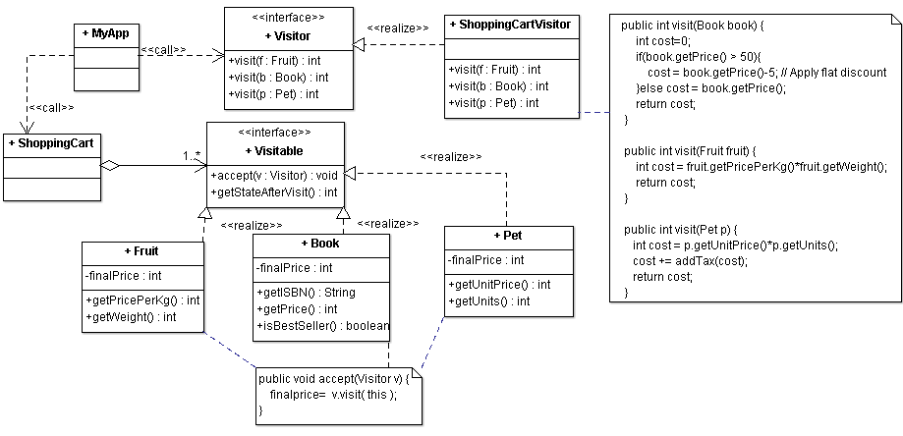
Visitor Pattern Class Diagram
declare the visit operations for all the types of concrete visitableclasses
Implements a specific activity (price computation) for all visitables
This is ObjectStructure
Another class that is a collection of visitable objects
Offers mechanisms to iterate over visitable

Slide 26
Visitor Pattern usage
public static void main(String[] args) {
ShoppingCartmyCart = new ShoppingCar();
myCart.add(new Book(20, "1234"));
myCart.add(new Book(100, "5678"));
myCart.add(new Fruit(10, 2, "Banana"));
myCart.add(new Fruit(5, 5, "Apple");
myCart.add(new Pet(100, 2, “Fish”)};
Visitor pricecalculator = new ShoppingCartVisitor();
intsum=0;
for(Visitableitem : shoppingCart.getList() ){
item.accept( pricecalculator);
sum += item.getStateAfterVisit();
}
System.out.println("Total Cost = "+ sum);
}

Slide 27
Consequences
Flexible design for adding new visitors to extend existing functionality without changing existing code
If a new Visitable class – say “ElectronicItem” is added all the implemented visitors need to be modified
What is the separation of visitors and visitable?
Visitors dependent on visitableBUT visitablesare not dependent on visitors.
Part of the dependency problems can be solved by using reflection with a performance cost

Slide 28
Visitor with Reflection Pattern
Suppose we need to add a new visitable class “ElectronicItem” in our structure
Make Visitor – abstract class
Create one visit(Visitable v) method instead of many visit() methods
Use reflection to get the exact concrete class of v (ElectronicItem)
Use reflection to check if there is any method in the concrete visitor class that implements visit(ElectronicItem). If so call this method
Otherwise execute a default visit method

Slide 29
Visitor and Composite Pattern
Can be used in addition with the composite pattern
The object structure can be a composite structure
In the implementation of the accept() method of the composite object
the accept methods of the component object has to be invoked

Slide 30
Difference between Iterator and Visitor
Both are used to traverse object structures
The main difference is
Iterator works on collections, usually containing objects of the same type. The visitor pattern can be used on complex structure such as hierarchical structures or composite structures.
The accept method of a complex object should call the accept method of all the child objects.
In one case the visitor defines the operations that should be performed, while the iterator is used by the client to iterate through the objects
The operations are defined by the client itself

Slide 31
Command Pattern
16.5

Slide 32
Motivation and intent
Encapsulate a request in an object
Allows the parameterization of clients with different requests
Allows saving the requests in a queue and call them one by one

Slide 33
Applicability
Need to parameterize objects depending on the action they must perform
Need to queue commands and execute them later
Need to provide undoable actions (the Execute method can memorize the state and allow going back to that state)
Need to build a system that comprises of high level operations, and each high level operation requires many primitive operations
Need to decouple the invoker from the action performer
Also known as Producer - Consumer design pattern

Slide 34
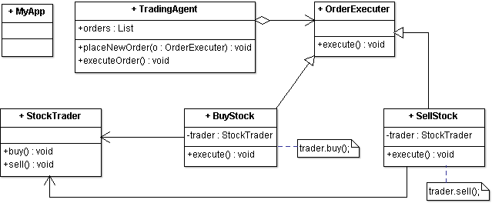
Class Diagram
The invoker who asks the command to carry out request
Abstract Command to execute an operation
Receiver who knows how to execute an operation
Concrete command, implements execute() by invoking appropriate operations on Receiver

Slide 35
Command Pattern usage
public static void main(String[] args) {
StockTraderstock = new StockTrader();
BuyStockbsc = new BuyStock(stock);
SellStockssc = new SellStock(stock);
TradingAgentagent = new TradingAgent();
// Buy Shares
agent.placeNewOrder(bsc);
// Sell Shares
agent.placeNewOrder(ssc);
}
Client creates orders for buy and sell (concrete command)
The agent (invoker) maintains a queue of commands to execute
It may execute a buy command on Monday if the request comes on Sunday
Buy command interacts with actual stock exchange (Receiver), gets the result and sends it back

Slide 36
Implementation Issues
How intelligent should a command be?
Just a link between receiver, does nothing else
Implements everything, does not need receiver
Undo and Redo
Command can keep a snapshot of the receiver state before calling receiver (sometimes difficult due to memory issues)
Stores set of performed operations
Receiver and command need to implement inverse operations
Asynchronous calls
Invoker sends requests to which are to be received in a separate threads
Threads may be limited, invoker can use thread pool

Slide 37
Command Pattern – Subtle Points
May look similar to Strategy pattern
Unlike strategy, it is not NOT about multiple implementation of the same algorithm
Command encapsulates the state and the action together
It acts like a standalone object (unlike strategy)
It can be passed around
The actual command performed can be undone/redone as it maintains the state
In the application context, you typically use many command objects at any time
In strategy you tend to use either/or

Slide 38
Thank You

